Slide 1
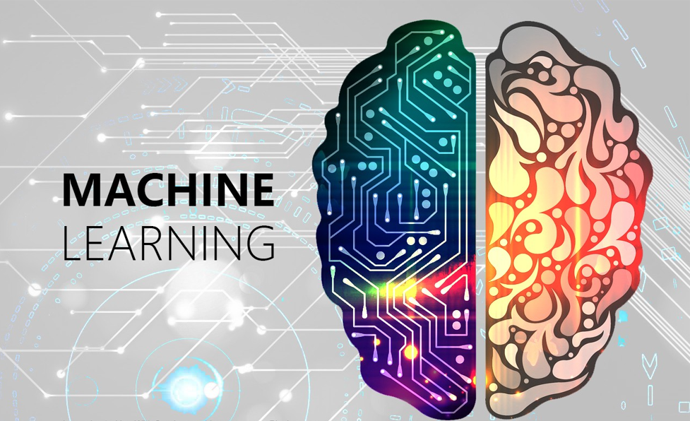
Eng. Mahmoud Ragab

Slide 2
Agenda
What is the Machine Learning and Why is It Important?
Types of Machine Learning Problems
Big Data and their importance
Machine Learning Applications
Machine Learning Steps
Machine Learning Prerequisites
Machine Learning Roadmap
Kaggle & Projects
Eng. Mahmoud Ragab

Slide 3
What is the Machine Learning ?
Machine learning is a branch of artificial intelligence (AI) and computer science which focuses on the use of data and algorithms to imitate the way that humans learn, gradually improving its accuracy.
Eng. Mahmoud Ragab

Slide 4
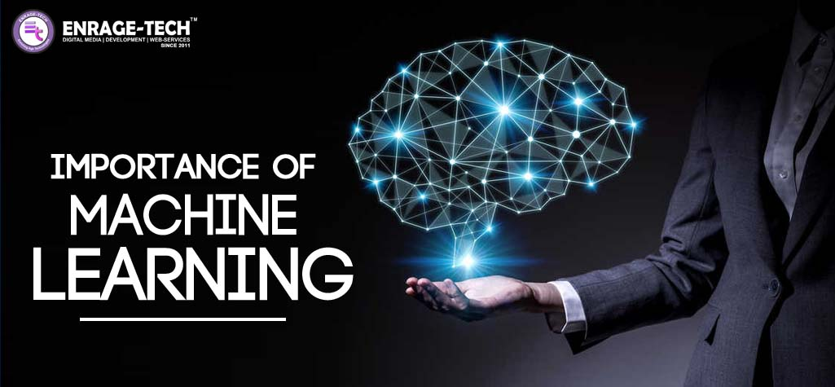
Why is Machine Learning important ?
Machine learning can be the key to unlock the value of customers data and make decisions.
Data processing is less financially cost than employing human hands.
Analyze the largest amount of data at all levels, whether simple or complex.
Ensuring more accurate results and decisions in the fastest time.
Eng. Mahmoud Ragab

Slide 5

Types of Machine Learning Problems
Eng. Mahmoud Ragab

Slide 6
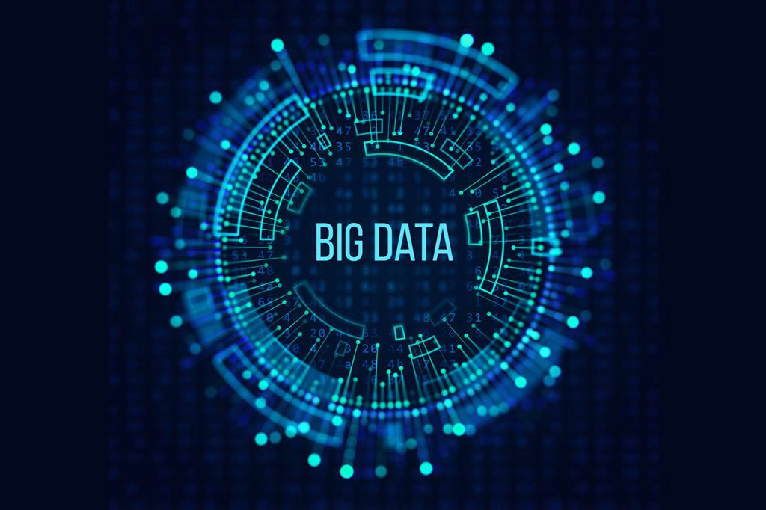
Big Data and their importance
Eng. Mahmoud Ragab

Slide 7
Eng. Mahmoud Ragab

Slide 8
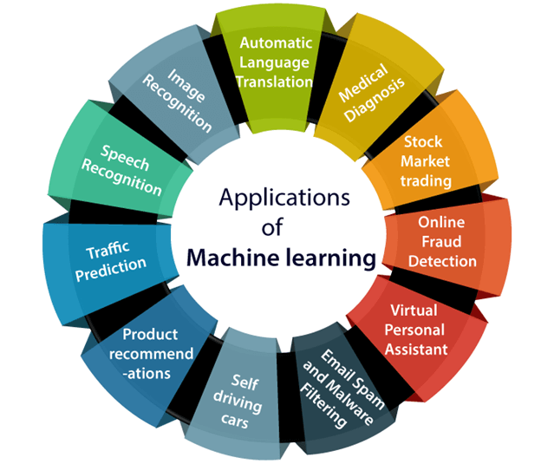
Machine Learning Applications
Eng. Mahmoud Ragab

Slide 9
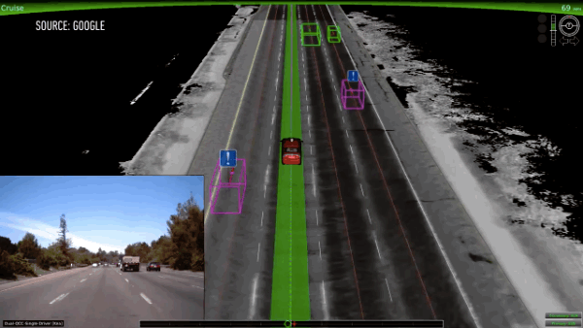

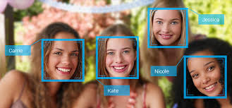
1- Image Recognition
used to identify objects, persons, places, digital images, Automatic friend tagging suggestion.
Eng. Mahmoud Ragab

Slide 10
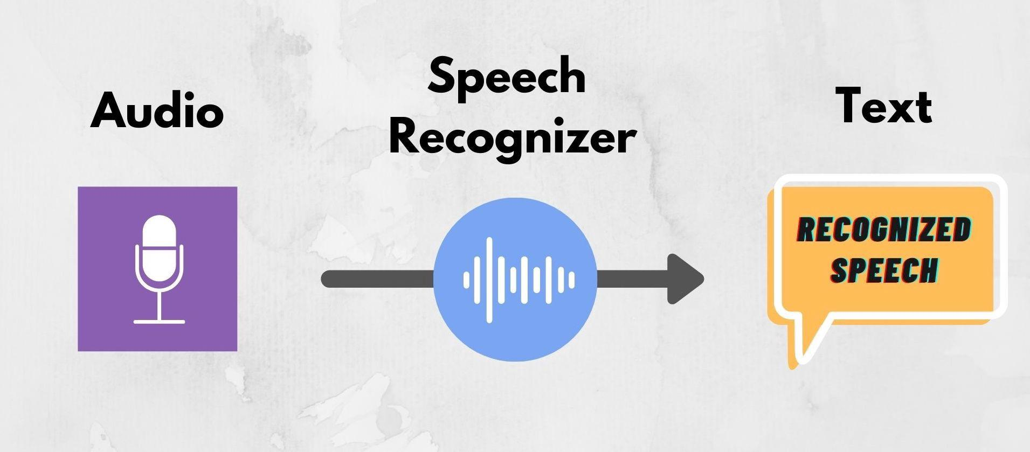
2- Speech Recognition
Search by voice , Speech to text , Google assistant , Cortana are using speech recognition technology to follow the voice instructions
Eng. Mahmoud Ragab

Slide 11




3- Recommendation System
Eng. Mahmoud Ragab

Slide 12

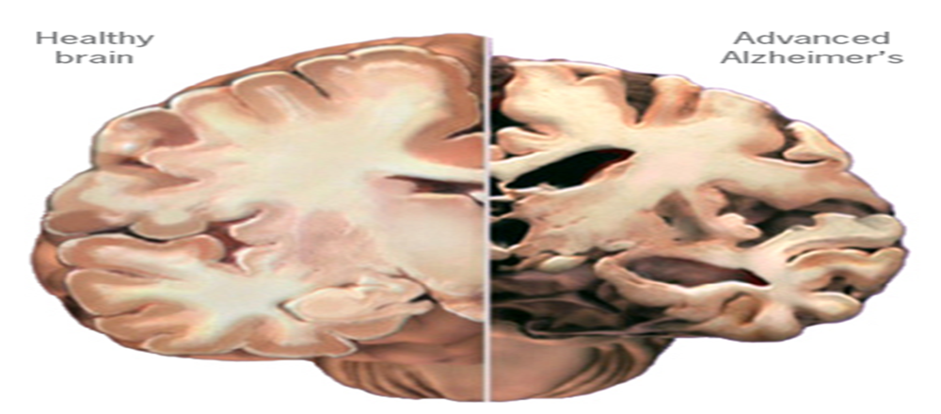
4- Medical Diagnosis
Eng. Mahmoud Ragab

Slide 13


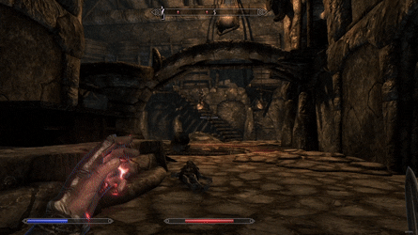
5- Games
Eng. Mahmoud Ragab

Slide 14
Machine Learning Steps
Data Collection
Data Cleaning and Preprocessing
Data Shuffling
Data Splitting (Training data + Test data)
Model Training
Model testing & evaluation
Model Deployment
Eng. Mahmoud Ragab

Slide 15


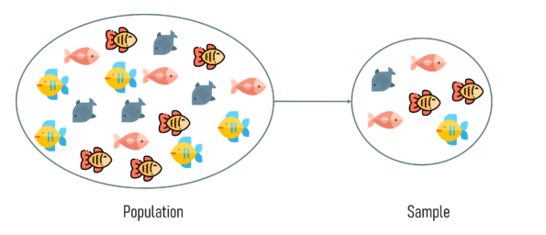
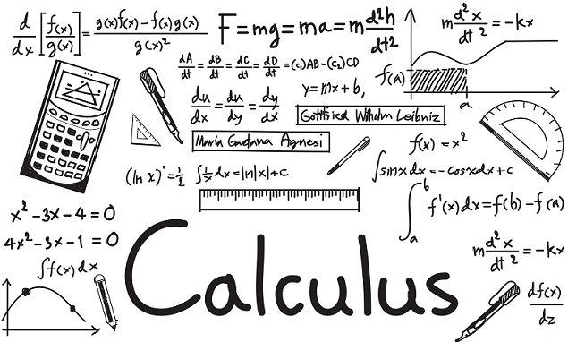
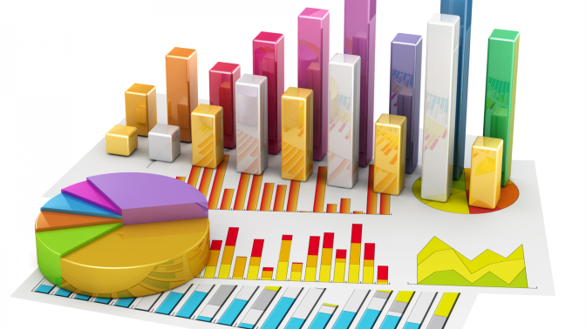
Machine Learning Prerequisites
Programming Language
Linear Algebra
Calculus
Statistics and Probability
Eng. Mahmoud Ragab

Slide 16
Machine Learning Roadmap
Eng. Mahmoud Ragab

Slide 17
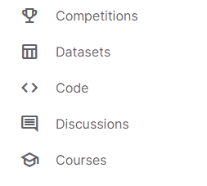

Kaggle & Projects
https://www.kaggle.com/
Eng. Mahmoud Ragab

Slide 18


Slide 19
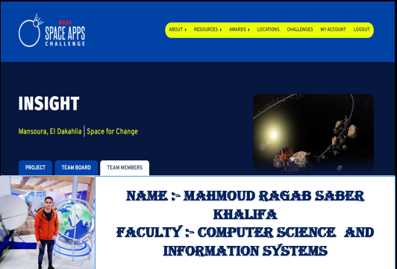

Slide 20
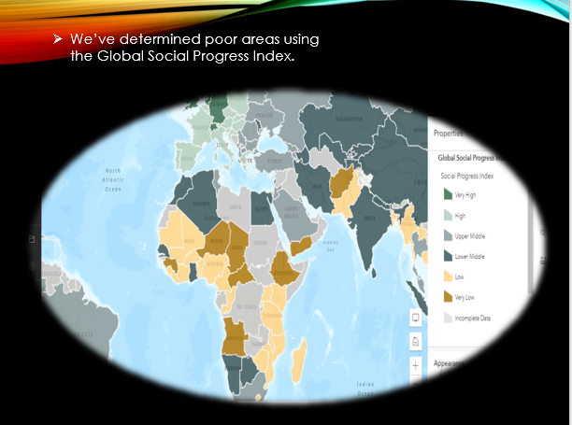

Slide 21
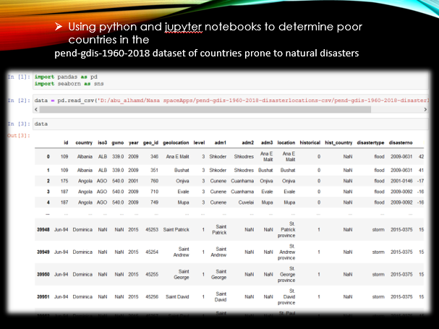

Slide 22
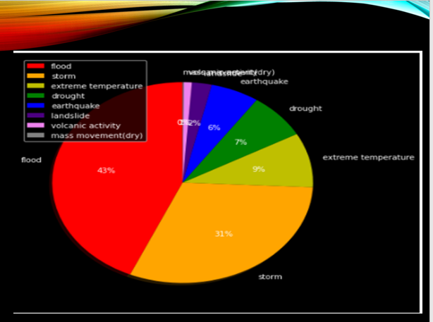
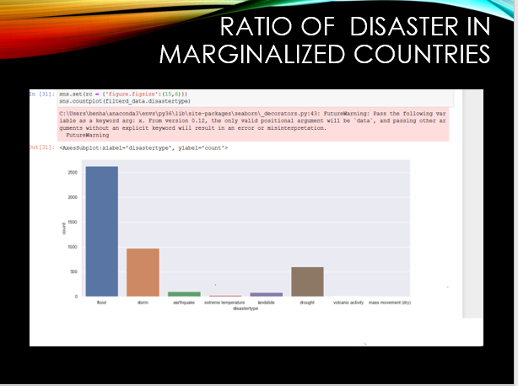

Slide 23
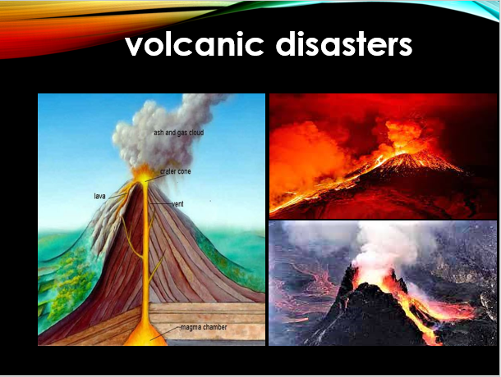

Slide 24
learning resources
https://www.youtube.com/c/HeshamAsem/playlists
https://www.geeksforgeeks.org/machine-learning/?ref=gcse
https://app.datacamp.com/learn/courses/preprocessing-for-machine-learning-in-python
https://www.kaggle.com/
Eng. Mahmoud Ragab

Slide 25

any questions ?
Eng. Mahmoud Ragab

Slide 26

Eng. Mahmoud Ragab

